Slide 1
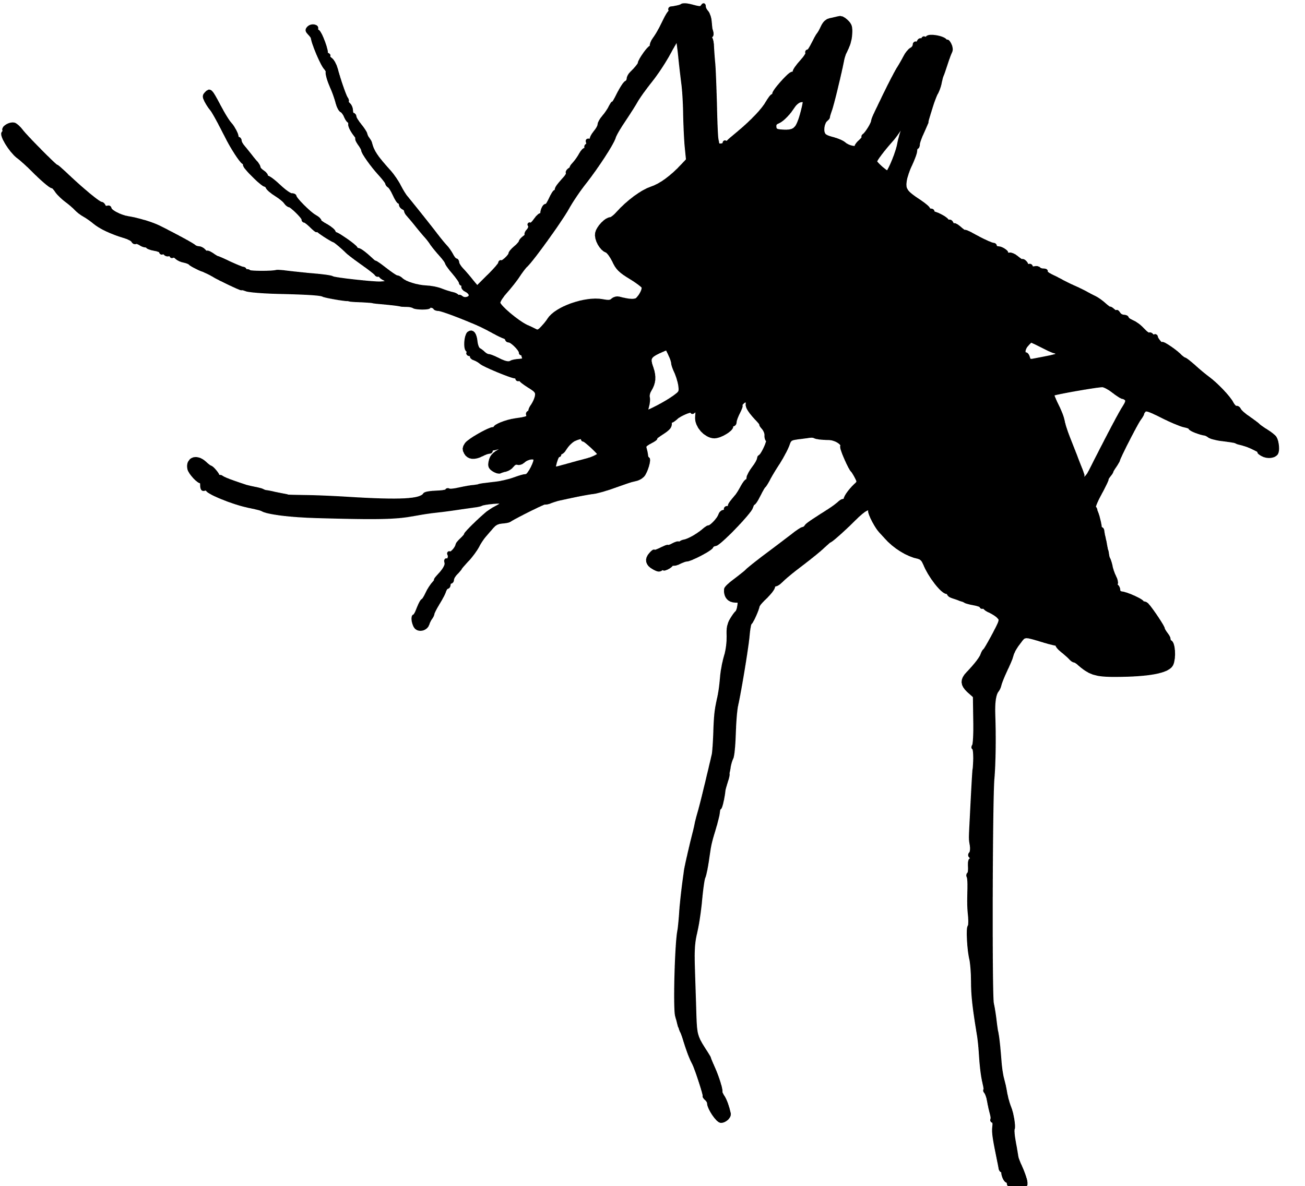
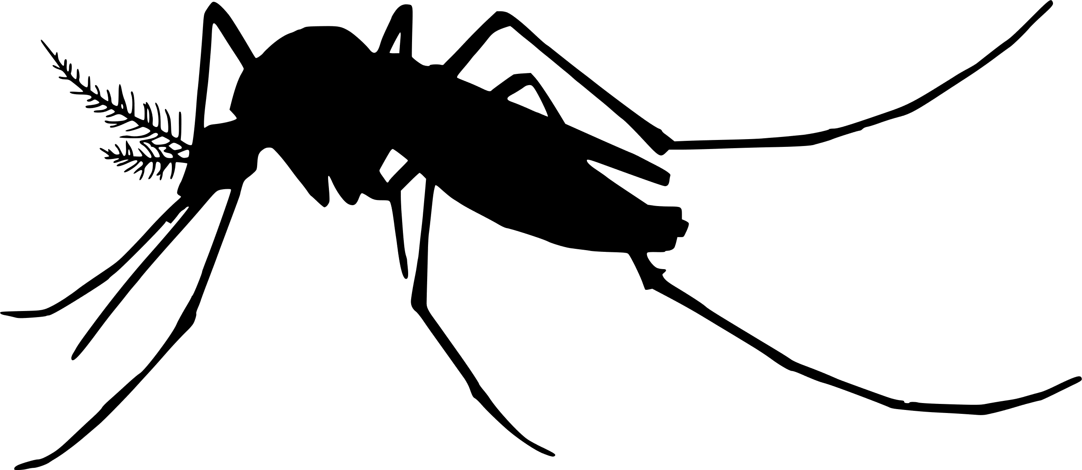
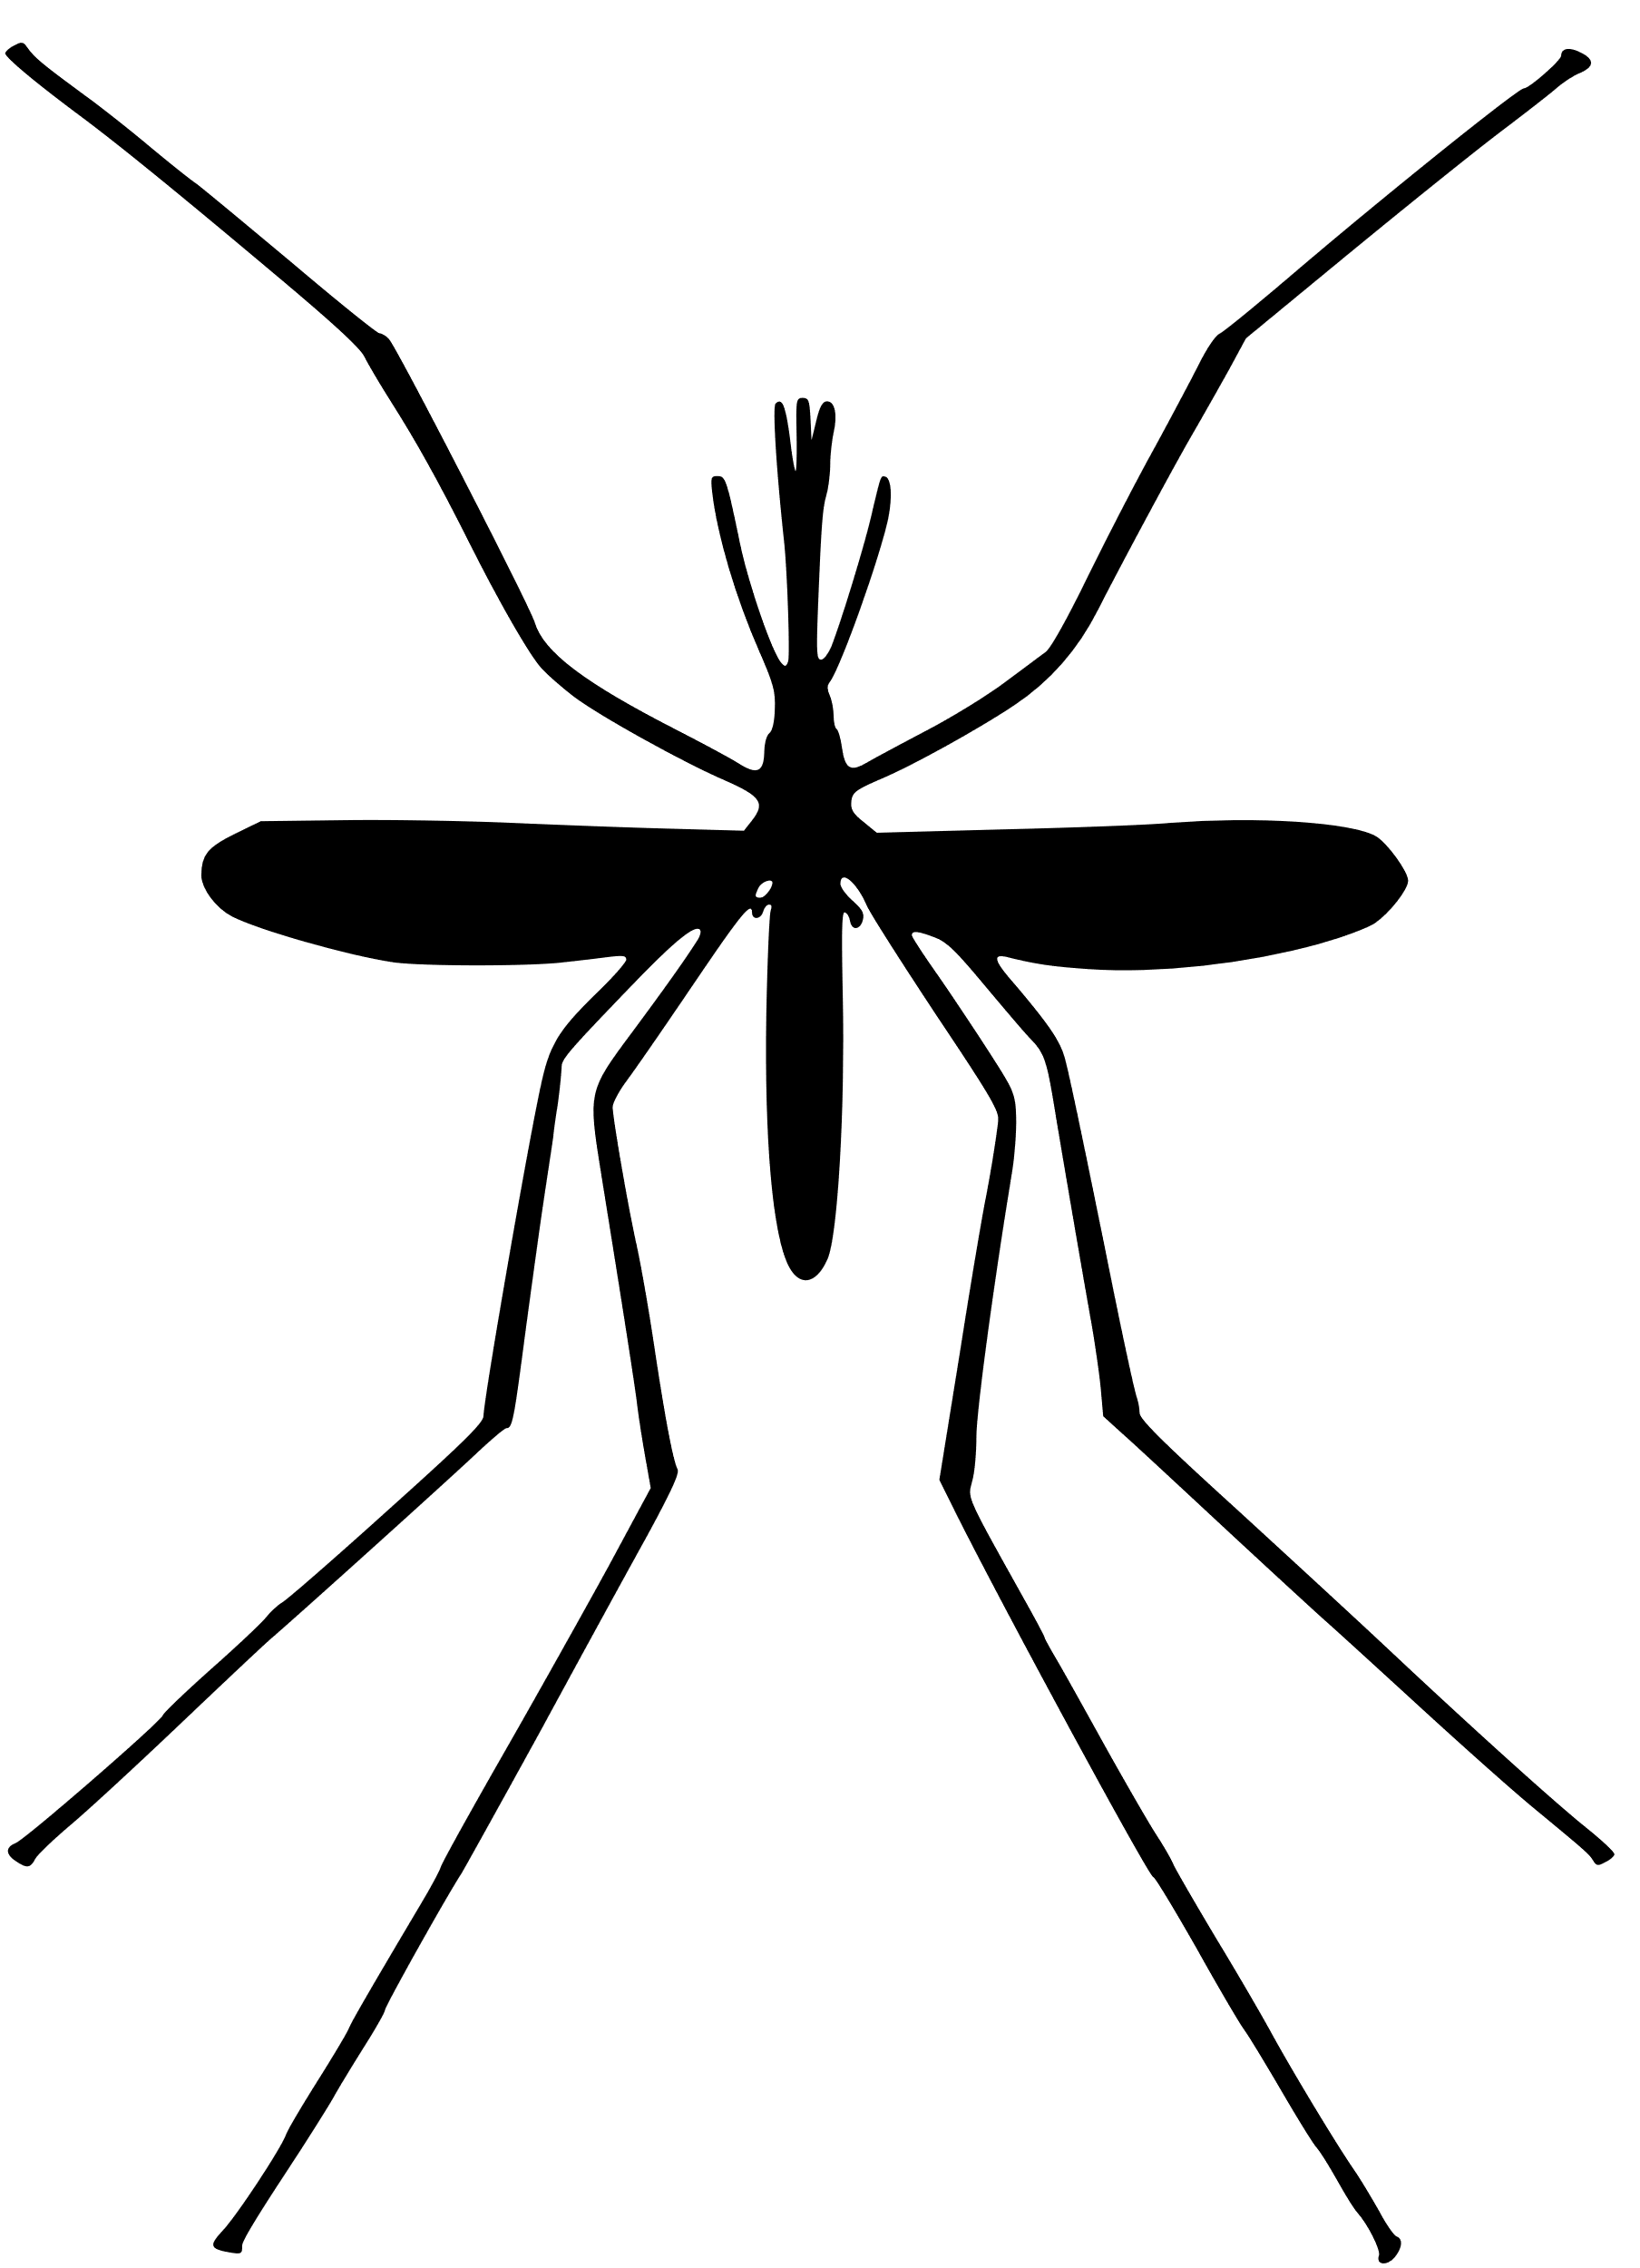

A framework for integrating complex mosquito feeding behaviors into disease transmission models
Kyle Dahlin
Virginia Tech, Department of Mathematics
Contact: kyledahlin@vt.edu
Joint Mathematics Meetings 2025, Seattle, WA
AMS Special Session on Harnessing the Power of Mathematical Models to Understand Population Dynamics, Ecology, and Evolution

Slide 2
Abstract:
The potential for mosquito-borne disease outbreaks is tightly linked to the frequency at which mosquitoes feed on blood, also known as their biting rate. However, standard models of mosquito-borne disease transmission assume that mosquitoes blood-feed only once per reproductive cycle – an assumption commonly violated in nature. Here we present a novel framework for incorporating more complex mosquito blood-feeding behaviors into transmission models. Although this extension can introduce many novel parameters, existing algorithms can be used to fit them to laboratory data. We provide formulas for the basic offspring and basic reproduction numbers, standard measures of mosquito population persistence and disease transmission risk, respectively, and show how they are linked to the introduced blood-feeding parameters.
To exhibit the utility of our framework, we compare the standard, exponential model to a more complicated mechanistic model derived from our framework, to show how assumptions about the blood-feeding process impact predictions about the potential for disease outbreaks. For example, it is commonly understood that – when biting rate is assumed to be the inverse of the gonotrophic cycle duration (the amount of time it takes a mosquito to complete a single reproductive cycle) – the basic reproduction number increases linearly with biting rate. However, if the gonotrophic cycle duration is altered by changing any of the rates or probabilities governing the mosquito blood-feeding process, we find that the relationship between the basic reproduction number and biting rate under this assumption is no longer linear. Through sensitivity analysis, we exhibit how this same mechanistic model can be used to determine which blood-feeding related parameters might be the most important targets for disease control. This provides a method for translating individual-level measurements of the efficacy of personal protective measures to reductions in population-level disease risk. This work provides a straightforward method for incorporating biological and ecological knowledge about mosquito blood-feeding into epidemiological models and highlights the importance of incorporating behavioral dynamics into transmission models.

Slide 3
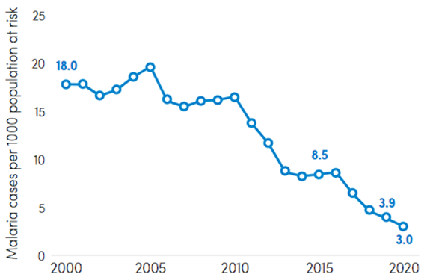
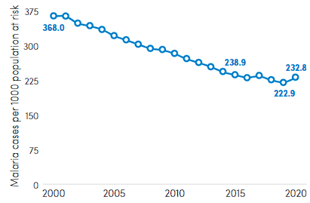
Progress on malaria elimination by 2030 has stalled
South-East Asia region
Africa region
Notes:
> 200 million cases of malaria and up to 400 million cases of dengue
>25% recent emerging infectious disease outbreaks due to MBDs (Jones 2008, Gould 2017)
Malaria has seen a recent uptick in some regions (World Malaria Report 2021)
Predicting MBD outbreaks is complex, needing to account for:
ecology of multiple hosts,
life history of the insect vectors, and
the traits of the pathogens themselves
environmental variables
coinfection
movement
immunology

Slide 4
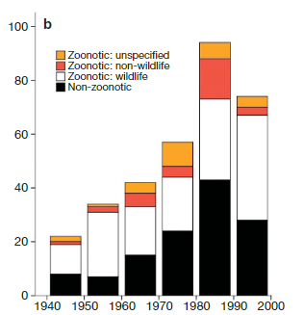
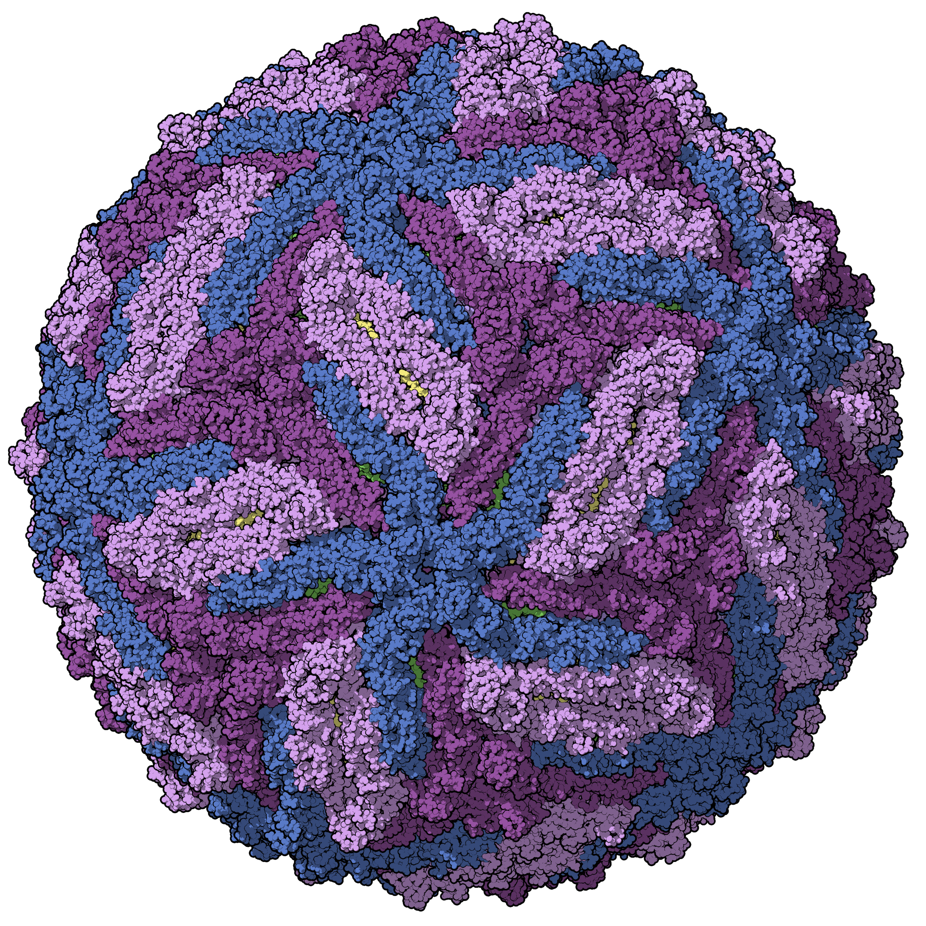
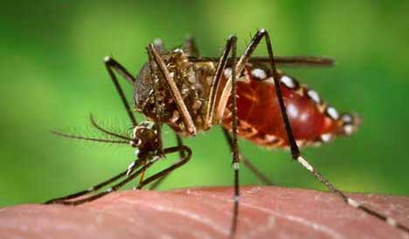
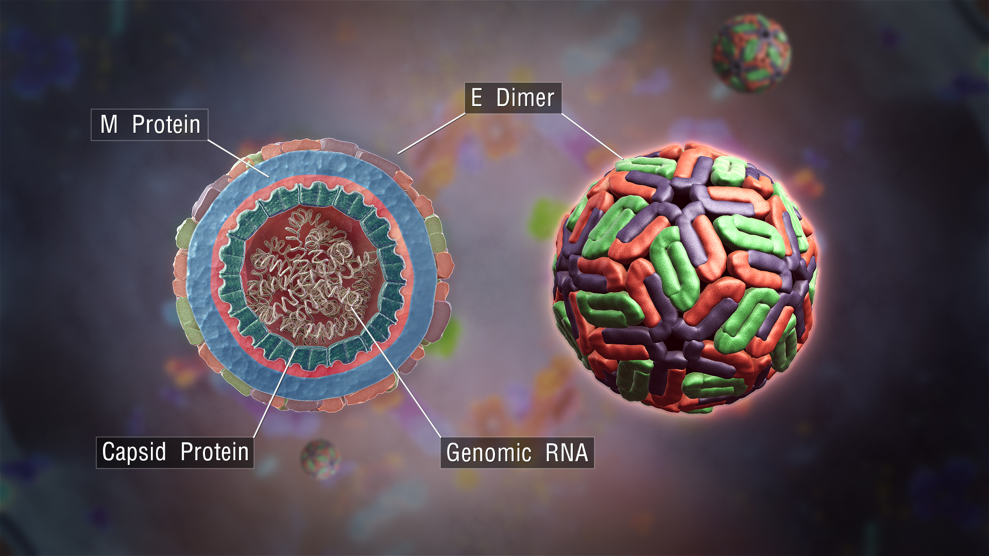
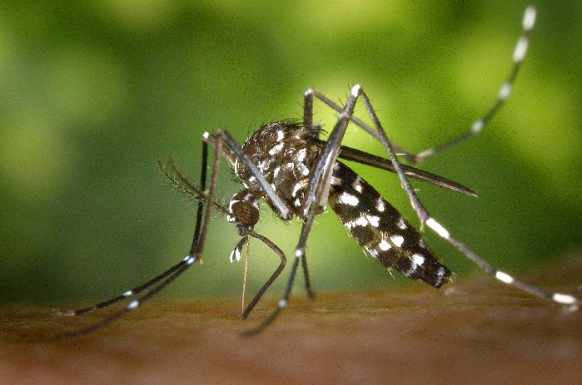
Over 25% of recent emerging infectious disease outbreaks were due to mosquito-borne zoonotic pathogens (Jones 2008, Gould 2017)
Aedes aegypti (CDC.gov)
Zika virus virion
(Manuel Almagro Rivas)
Dengue virus virion (ScientificAnimations.com)
Aedes albopictus (CDC.gov)
Jones, K., Patel, N., Levy, M. et al. Global trends in emerging infectious diseases. Nature 451, 990–993 (2008).
Notes:
Emerging infectious diseases

Slide 5
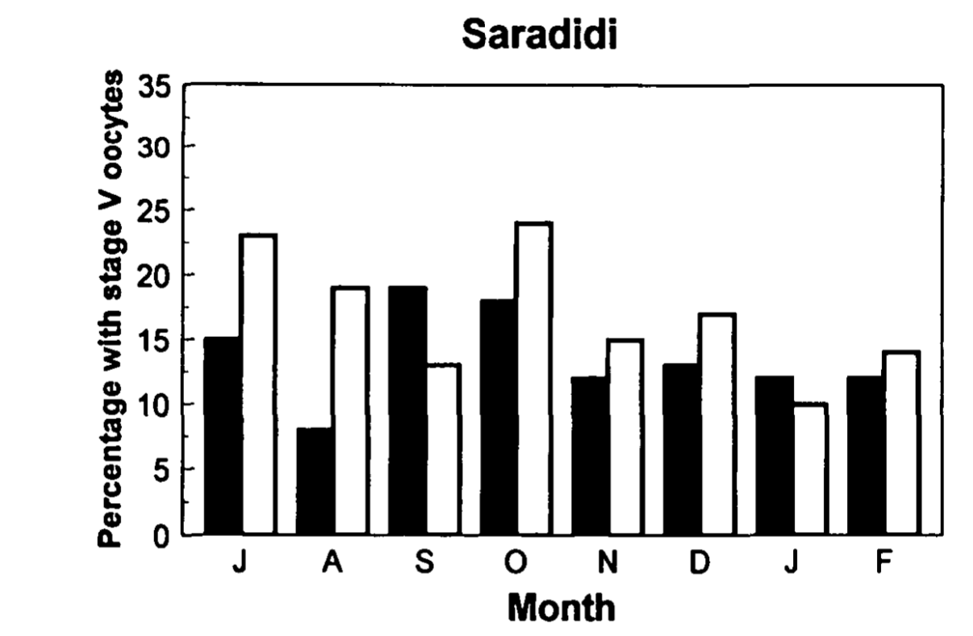
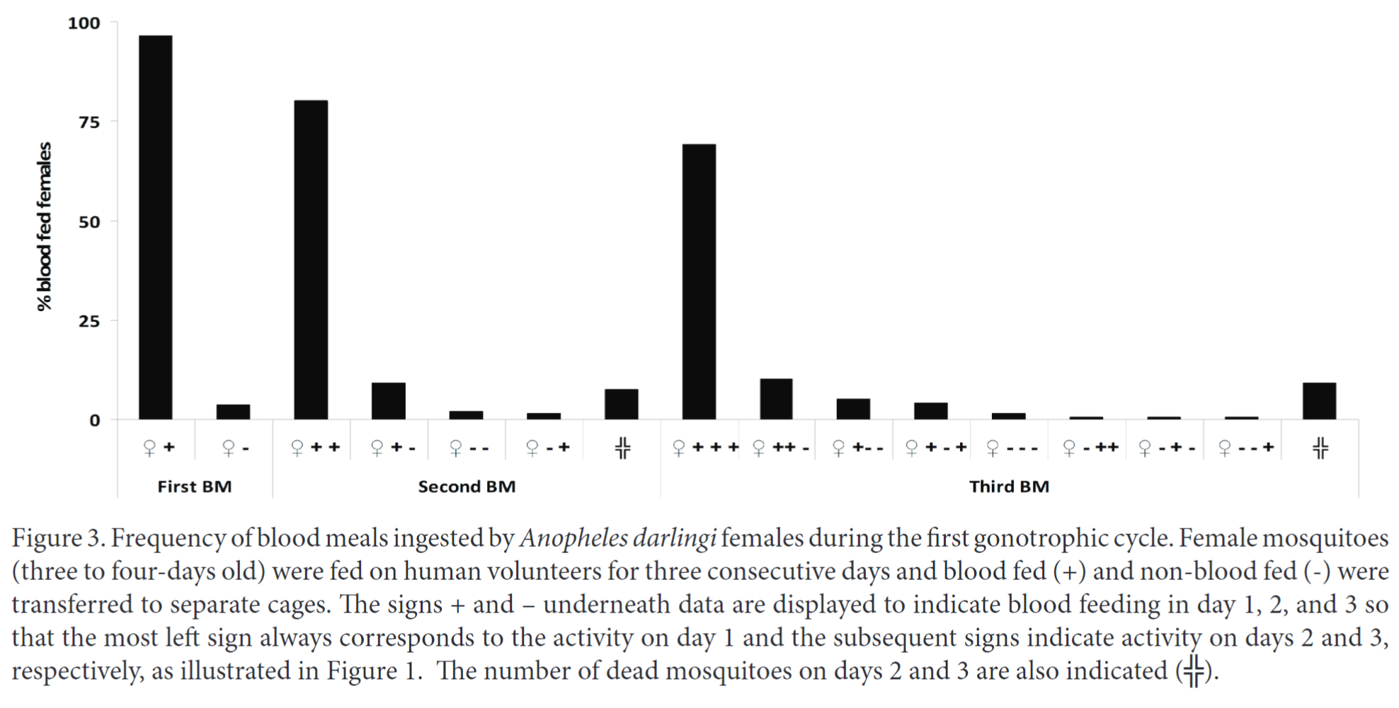
Multiple biting – attempting to feed more than once in a reproductive cycle – is common among mosquitoes
1
2
3
1
2
0
0
1
1
2
0
2
1
1
Proportion of Anopheles gambiae and An. Funestus mosquitoes taking an additional blood meal
Modified from Beier (1996) J Med Entomol
Frequency of blood meals ingested by Anopheles darlingi females in a single gonotrophic cycle. Numbers above bars indicate total number of blood meals.
Modified from de Oliveira et al. (2012) J Vector Ecol
Notes:
NB: We use the term “multiple blood feeding” generically to include both interrupted and mixed blood feeding
Particularly true for Anopheles mosquitoes: the primary culprits in transmission of malaria parasites

Slide 6
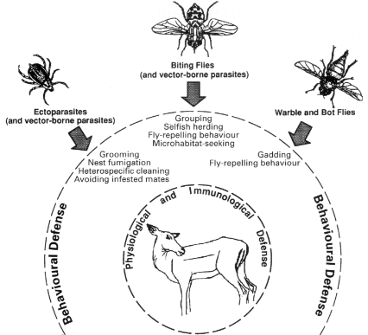
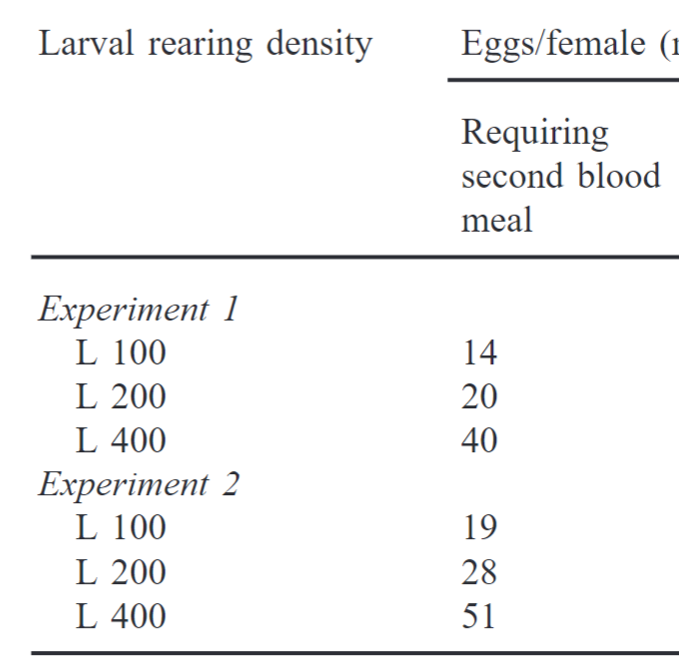
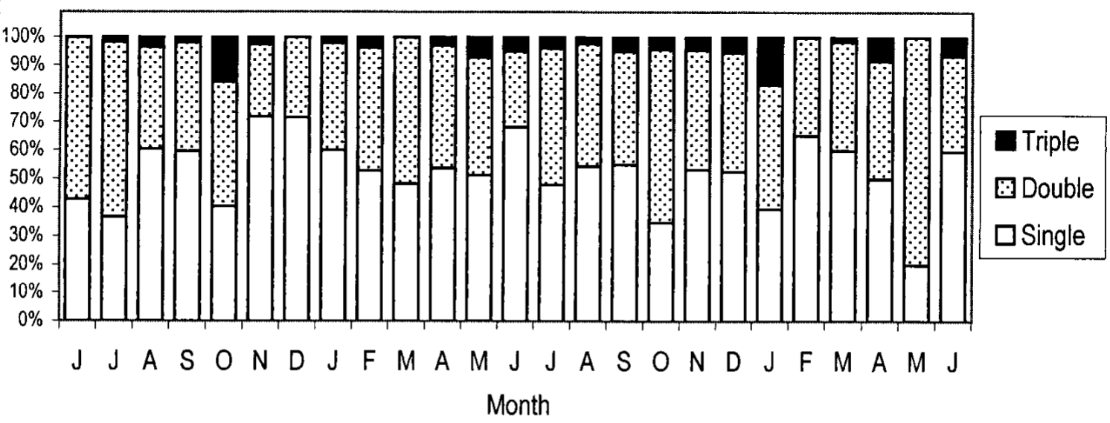
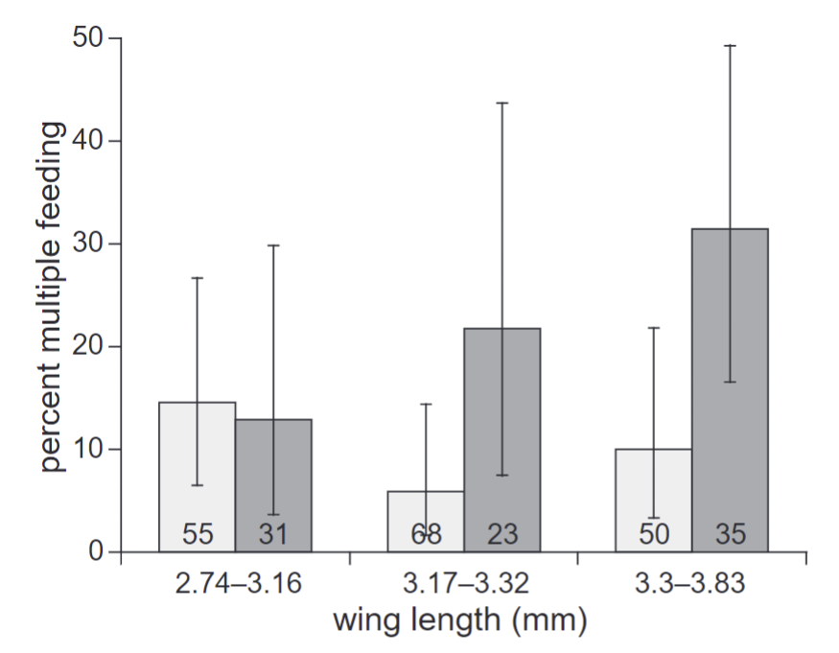
Drivers of multiple biting
Infection status or
body size
Seasonality
Population density
Uninfected with malaria
Infected with malaria
Seasonality drives patterns in multiple blood feeding for Aedes aegypti
Modified from Scott et al. (2000) J Med Entomol
Effect of size and infection status (Plasmodium falciparum) on the probability of Anopheles gambiae having multiple blood meals
Modified from Koella, et al (1998) Proc Biol Sci
Ramasamy et al. (2000) J Insect Physiol
Hosts have an array of defensive strategies they can employ to avoid insect blood feeding
Hart (1994) Parasitology

Slide 7
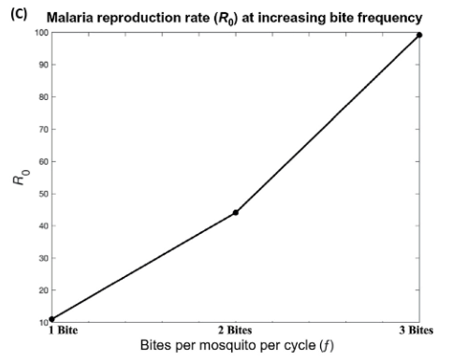
Multiple biting may multiply transmission
More frequent feeding attempts
3x increase in biting frequency
→ 10x increase in in transmission
More frequent contact with hosts
More opportunities for disease transmission
Tedrow, R. E., P. A. Zimmerman, and K. C. Abbott. 2019. Multiple Blood Feeding: A Force Multiplier for Transmission. Trends in parasitology 35:949–952.

Slide 8
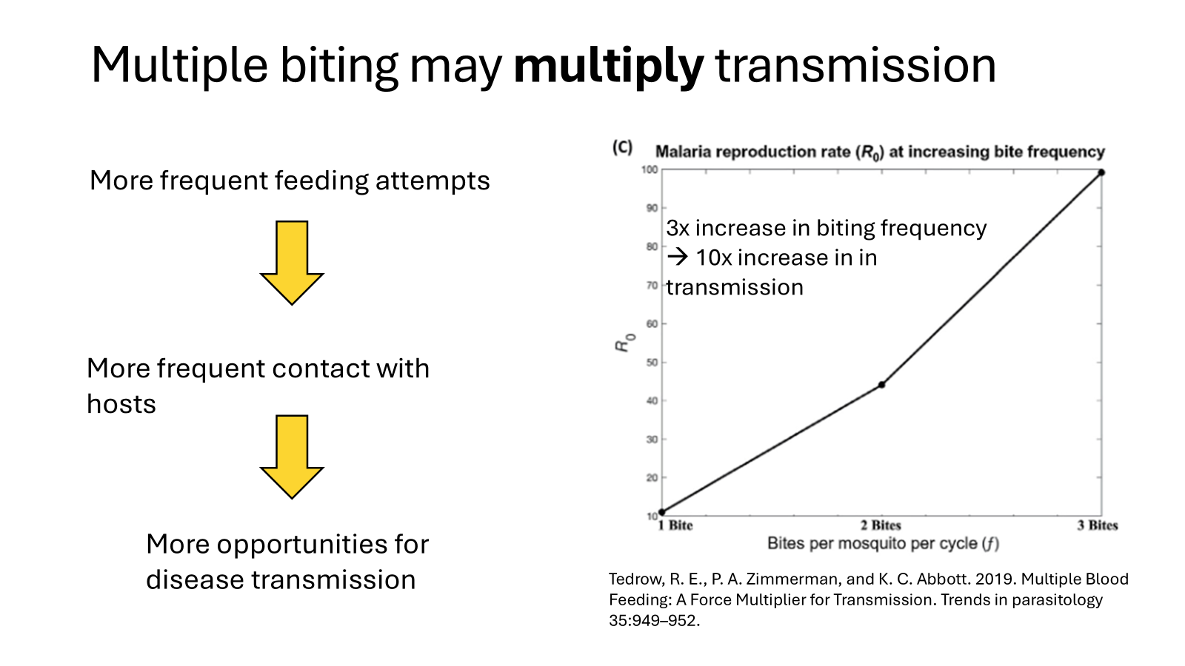
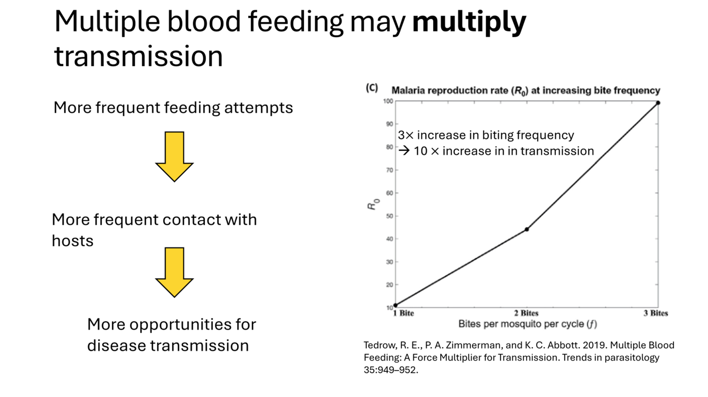
Does multiple blood-feeding always multiply transmission?
Or do the specific mechanisms or drivers matter?

Slide 9


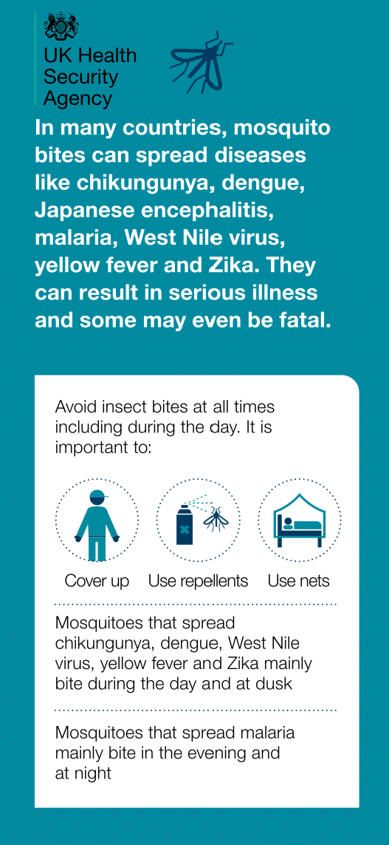


Slide 10



Personal protection measures are commonly recommended for mosquito-borne disease prevention

Slide 11

Commonly-recommended personal protective measures
are not included in mosquito-borne disease models.
How might they affect predictions of long term disease spread?

Slide 12
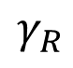
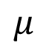
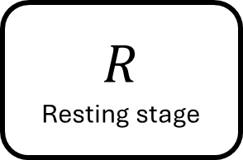
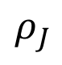
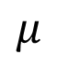
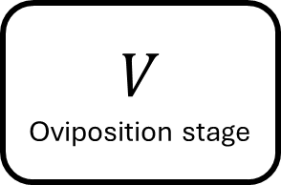
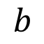
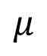
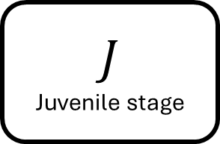
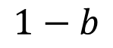
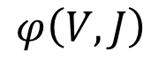
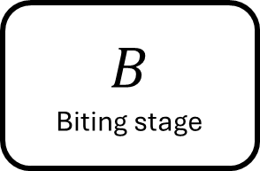
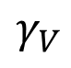
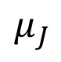
$$μ$$
$$μ$$
$$R$$
Resting stage
$$γ_{V}$$
$$V$$
Oviposition stage
$$1−b$$
$$γ_{R}$$
$$φ\left(V,J\right)$$
$$J$$
Juvenile stage
$$ρ_{J}$$
$$B$$
Biting stage
$$b$$
$$μ_{J}$$
$$μ$$

Slide 13
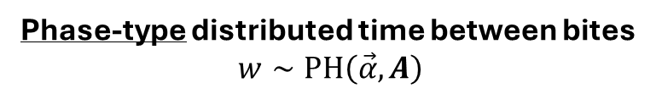
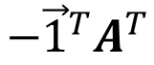
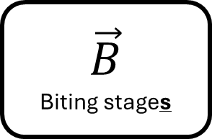
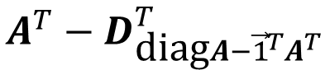
$$μ$$
$$μ$$
$$R$$
Resting stage
$$γ_{V}$$
$$V$$
Oviposition stage
$$A^{T}−D_{\text{diag}A−{\vec{1}}^{T}A^{T}}^{T}$$
$$γ_{R}$$
$$φ\left(V,J\right)$$
$$J$$
Juvenile stage
$$ρ_{J}$$
$$\vec{B}$$
Biting stages
$$−{\vec{1}}^{T}A^{T}$$
$$μ_{J}$$
$$μ$$
Phase-type distributed time between bites
$$w∼\text{PH}\left(\vec{α},A\right)$$

Slide 14
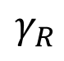
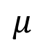
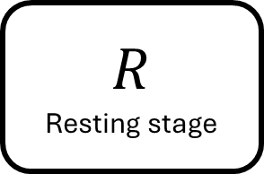
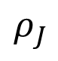
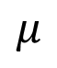
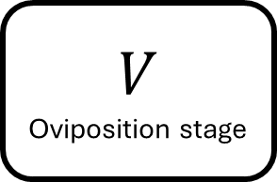
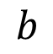
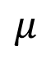
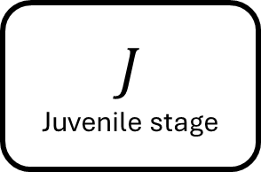
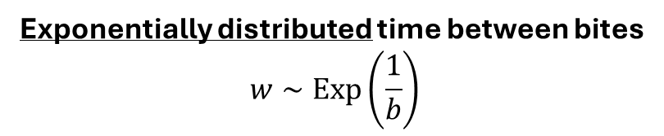
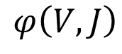
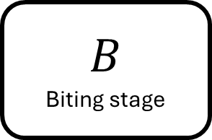


Model formulation
Exponential
$$μ$$
$$μ$$
$$R$$
Resting stage
$$γ_{V}$$
$$V$$
Oviposition stage
$$γ_{R}$$
Gonotrophic cycle
$$φ\left(V,J\right)$$
$$J$$
Juvenile stage
$$ρ_{J}$$
$$B$$
Biting stage
$$b$$
$$μ_{J}$$
$$μ$$
Exponentially distributed time between bites
$$w∼\text{Exp}\left(\frac{1}{b}\right)$$

Slide 15





Model formulation
Phase-type
Replace exponentially-distributed biting periods with phase-type
The matrix $A$ contains the transition rates among the transient biting stages, $\vec{B}$
$$μ$$
$$μ$$
$$R$$
Resting stage
$$γ_{V}$$
$$V$$
Oviposition stage
$$γ_{R}$$
$$A^{T}−D_{\text{diag}A−{\vec{1}}^{T}A^{T}}^{T}$$
$$φ\left(V,J\right)$$
$$J$$
Juvenile stage
$$ρ_{J}$$
$$−{\vec{1}}^{T}A^{T}$$
$$\vec{B}$$
Biting stages
$$μ_{J}$$
$$μ$$
Phase-type distributed time between bites
$$w∼\text{PH}\left(\vec{α},A\right)$$

Slide 16


The blood-feeding process
Seeking and finding host
“Successful hematophagy culminates in an intricate cascade of events.” – John D. Edman and Andrew Spielman
Landing
Probing
Ingesting
Repletion:
Proceed to oviposition stage

Slide 17

The real blood-feeding process
Seeking and finding host
Success
Landing
Transmission to host
Probing
Depart and quest for new host
Failure
Ingesting
Transmission to vector
Repletion:
Proceed to oviposition stage
Persist on same host
Notes:
Maybe: combine probing, salivation, and feeding then break them out later when focusing on transmission

Slide 18
Resting
Ovipositing
Seeking and finding host
Repletion:
Proceed to oviposition stage
Landing
Transmission to host
Probing
Depart and quest for new host
Transmission to vector
Ingesting
Persist on same host

Slide 19


















$$R$$
$$γ_{V}$$
$$V$$
$$γ_{R}$$
$$ρ_{J}$$
$$Q$$
$$λ_{Q}$$
$$L$$
$${p_{G}λ}_{G}$$
$${\left(1−σ\right)\left(1−p_{L}\right)λ}_{L}$$
$${p_{L}λ}_{L}$$
$$P$$
$$σ{\left(1−p_{P}\right)λ}_{P}$$
$${p_{P}λ}_{P}$$
$$\left(1−σ\right){\left(1−p_{P}\right)λ}_{P}$$
$$G$$
$$σ{\left(1−p_{G}\right)λ}_{G}$$
$$\left(1−σ\right){\left(1−p_{G}\right)λ}_{G}$$

Slide 20









$$R$$
$$γ_{V}$$
$$V$$
$$p_{X}$$ | Probability of progressing successfully from stage $X$
$$γ_{R}$$
$$ρ_{J}$$
$$Q$$
$$λ_{Q}$$
$$L$$
$${p_{G}λ}_{G}$$
$${\left(1−σ\right)\left(1−p_{L}\right)λ}_{L}$$
$${p_{L}λ}_{L}$$
$$P$$
$$σ{\left(1−p_{P}\right)λ}_{P}$$
$${p_{P}λ}_{P}$$
$$\left(1−σ\right){\left(1−p_{P}\right)λ}_{P}$$
$$G$$
$$σ{\left(1−p_{G}\right)λ}_{G}$$
$$\left(1−σ\right){\left(1−p_{G}\right)λ}_{G}$$

Slide 21










$$R$$
$$γ_{V}$$
$$V$$
$$p_{X}$$ | Probability of progressing successfully from stage $X$
$$λ_{X}$$ | Rate of progression from stage $X$
$$γ_{R}$$
$$ρ_{J}$$
$$Q$$
$$λ_{Q}$$
$$L$$
$$p_{G}λ_{G}$$
$$\left(1−σ\right)\left(1−p_{L}\right)λ_{L}$$
$$p_{L}λ_{L}$$
$$P$$
$$σ\left(1−p_{P}\right)λ_{P}$$
$$p_{P}λ_{P}$$
$$\left(1−σ\right)\left(1−p_{P}\right)λ_{P}$$
$$G$$
$$σ\left(1−p_{G}\right)λ_{G}$$
$$\left(1−σ\right)\left(1−p_{G}\right)λ_{G}$$

Slide 22






$$R$$
$$γ_{V}$$
$$V$$
$$p_{X}$$ | Probability of progressing successfully from stage $X$
$$λ_{X}$$ | Rate of progression from stage $X$
$$σ$$ | Probability of persisting on the same host
$$γ_{R}$$
$$ρ_{J}$$
$$Q$$
$$λ_{Q}$$
$$L$$
$${p_{G}λ}_{G}$$
$${\left(1−σ\right)\left(1−p_{L}\right)λ}_{L}$$
$${p_{L}λ}_{L}$$
$$P$$
$$σ{\left(1−p_{P}\right)λ}_{P}$$
$${p_{P}λ}_{P}$$
$$\left(1−σ\right){\left(1−p_{P}\right)λ}_{P}$$
$$G$$
$$σ{\left(1−p_{G}\right)λ}_{G}$$
$$\left(1−σ\right){\left(1−p_{G}\right)λ}_{G}$$

Slide 23



$$R$$
$$γ_{V}$$
$$V$$
$$p_{X}$$ | Probability of progressing successfully from stage $X$
$$λ_{X}$$ | Rate of progression from stage $X$
$$σ$$ | Probability of persisting on the same host
$$1/γ_{V}$$ | Average oviposition duration
$$1/γ_{R}$$ | Average resting period
$$γ_{R}$$
$$ρ_{J}$$
$$Q$$
$$λ_{Q}$$
$$L$$
$${p_{G}λ}_{G}$$
$${\left(1−σ\right)\left(1−p_{L}\right)λ}_{L}$$
$${p_{L}λ}_{L}$$
$$P$$
$$σ{\left(1−p_{P}\right)λ}_{P}$$
$${p_{P}λ}_{P}$$
$$\left(1−σ\right){\left(1−p_{P}\right)λ}_{P}$$
$$G$$
$$σ{\left(1−p_{G}\right)λ}_{G}$$
$$\left(1−σ\right){\left(1−p_{G}\right)λ}_{G}$$

Slide 24















Blood-feeding process transient rate matrix
 |  | $$0$$ | $$0$$
 |  |  | $$0$$
 |  | $$0$$
$$−λ_{Q}$$
$$λ_{Q}$$
$${\left(1−σ\right)\left(1−p_{L}\right)λ}_{L}$$
$$−λ_{L}+σ\left(1−f\right)\left(1−p_{L}\right)λ_{L}$$
$${p_{L}λ}_{L}$$
$$A$$
$$A$$
$$=$$
$$\left(1−σ\right){\left(1−p_{P}\right)λ}_{P}$$
$$σ{\left(1−p_{P}\right)λ}_{P}$$
$$−λ_{P}$$
$${p_{P}λ}_{P}$$
$$\left(1−σ\right){\left(1−p_{G}\right)λ}_{G}$$
$$σ{\left(1−p_{G}\right)λ}_{G}$$
$$−λ_{G}$$
Notes:
Maybe: combine probing, salivation, and feeding then break them out later when focusing on transmission

Slide 25
$$R$$
$$γ_{V}$$
$$V$$
$$γ_{R}$$
$$ρ_{J}$$
$$Q$$
$$λ_{Q}$$
$$L$$
$${p_{G}λ}_{G}$$
$${\left(1−σ\right)\left(1−p_{L}\right)λ}_{L}$$
$${p_{L}λ}_{L}$$
$$P$$
$$σ{\left(1−p_{P}\right)λ}_{P}$$
$${p_{P}λ}_{P}$$
$$\left(1−σ\right){\left(1−p_{P}\right)λ}_{P}$$
$$G$$
$$σ{\left(1−p_{G}\right)λ}_{G}$$
$$\left(1−σ\right){\left(1−p_{G}\right)λ}_{G}$$

Slide 26



Generalized linear
chain trick (GLCT)
Biting process transient rate matrix
Mean-field ODEs of biting process dynamics
$$A$$
$$A$$
Notes:
Maybe: combine probing, salivation, and feeding then break them out later when focusing on transmission

Slide 27
Generalized linear
chain trick (GLCT)
Biting process transient rate matrix
Mean-field ODEs of biting process dynamics
$$A$$
$$A$$
$$A$$
Notes:
Maybe: combine probing, salivation, and feeding then break them out later when focusing on transmission

Slide 28







Parasite transmission and development
Susceptible
$$\frac{d}{dt}{\overset{⃑}{S}}_{B}=\left(ρ_{J}J+γV\right) \overset{⃑}{α}−Φ_{B}{\vec{S}}_{B}−\left(μI−{ }^{T}\right){\overset{⃑}{S}}_{B}$$
$$A$$
Exposed
$$\frac{d}{dt}{\overset{⃑}{E}}_{B}=Φ_{B}{\vec{S}}_{B}−η{\vec{E}}_{B}−\left(μI−{ }^{T}\right){\overset{⃑}{E}}_{B}$$
$$A$$
Infected
$$\frac{d}{dt}{\overset{⃑}{I}}_{B}=η{\vec{E}}_{B}−\left(μI−{ }^{T}\right){\overset{⃑}{I}}_{B}$$
$$A$$
$$A$$
Notes:
Maybe: combine probing, salivation, and feeding then break them out later when focusing on transmission

Slide 29






$$V$$
$$R$$
$$Q$$
$$L$$
$$P$$
$$G$$

Slide 30
Mosquito population
Susceptible
Exposed
Infectious
Exposure
Pathogen development
Host population
Recovered
Infected
Susceptible

Slide 31


Slide 32
Mosquito population
Susceptible
Exposed
Infectious
Host population
Recovered
Infected
Susceptible

Slide 33
Mosquito population
Susceptible
Exposed
Infectious
Exposure
Host population
Recovered
Infected
Susceptible

Slide 34
Mosquito population
Pathogen development
Susceptible
Exposed
Infectious
Exposure
Host population
Recovered
Infected
Susceptible

Slide 35
Mosquito population
Pathogen development
Susceptible
Exposed
Infectious
Exposure
Host population
Recovered
Infected
Susceptible

Slide 36
Average duration
Possibly zero, they only
need sugar or water if they’re low
Average duration 2 – 3 days
Average duration
2 – 3 days
Resting / Sugar-feeding
Egg-laying
Resting / Digesting / Egg development / Oviposition site searching
Clement’s Aedes estimates
Average duration
< 5 minutes total
Average duration
Possibly instantaneous
Questing / Host-seeking
Landing
Probing
Ingesting
Average duration
Development from Egg → Adult
References:
Tuno Nobuko – defensiveness
Wynne…Vinauger – visual threats…
Newly-emerged mosquitoes
2-3 days before first host-seeking
Includes mating and sugar-feeding
Notes:
Maybe: combine probing, salivation, and feeding then break them out later when focusing on transmission

Slide 37
Average duration
2 – 5 days
Average duration 1 hour
Average duration
2 days
Resting
Egg-laying
Resting / Egg development
Average duration
8 hours – 1 day
Average duration
< 10 minutes
Average duration
< 2 minutes
Average duration
< 1 minute
Questing
Landing
Probing
Ingesting
Newly-emerged mosquitoes
2 days to 2 weeks development period from egg to adult
Notes:
Maybe: combine probing, salivation, and feeding then break them out later when focusing on transmission

Slide 38




How does a mosquito become infected?
How does a human become infected?
It successfully locates a host, then lands on it, then probes, then begins ingesting
Equivalent to being in compartment $S_{G}$
The probability of locating a host may be density-dependent
The host is infectious
Probability is equal to $\frac{I_{H}}{H}$
This can be determined at the point of probing. The probability that the host has transitioned from infected to recovered over this short period is negligible.
The infection takes hold
A mosquito successfully locates
This probability may be density-dependent or it could be inevitable
The mosquito successfully lands on it and begins probing
The probability the mosquito is in this stage is $\frac{P}{P+L+G}$? because we know it’s made it past the questing stage.
The probing mosquito is infectious
Probability is equal to $\frac{I_{P}}{P}=\frac{I_{P}}{S_{P}+I_{P}}$
Do we need to keep track of whether the mosquito is infectious at the point of location? Or can we take the baseline probability that the mosquito is infectious?
The infection takes hold
$$Φ_{V}\left[\begin{aligned}S_{Q} \\ S_{L} \\ S_{P} \\ S_{G}\end{aligned}\right]=\left[\begin{aligned}0 \\ 0 \\ 0 \\ S_{G}\end{aligned}\right]×\frac{I_{H}}{H}×β_{V}×"λ"$$
$$Φ_{H}S_{H}=S_{H}×\operatorname{Pr}\left(\text{contacted}\right)×\frac{P}{P+L+G}×\frac{I_{P}}{P}×β_{H}×"λ"$$

Slide 39









$$R$$
Resting stage
$$γ_{V}$$
$$V$$
Oviposition stage
$$γ_{R}$$
$$φ\left(V,J\right)$$
$$J$$
Juvenile stage
$$ρ_{J}$$
$$B$$
Biting stage
$$−{\vec{1}}^{T}A^{T}$$

Slide 40


















$$R$$
Resting stage
$$γ_{V}$$
$$V$$
Oviposition stage
$$γ_{R}$$
$$ρ_{J}$$
$$Q$$
Host-seeking
$$λ_{Q}$$
$$L$$
Landing
$${p_{G}λ}_{G}$$
$${\left(1−p_{L}\right)λ}_{L}$$
$${p_{L}λ}_{L}$$
$$P$$
Probing
$$σ{\left(1−p_{P}\right)λ}_{P}$$
$${p_{P}λ}_{P}$$
$$\left(1−σ\right){\left(1−p_{P}\right)λ}_{P}$$
$$G$$
Ingesting
$$σ{\left(1−p_{G}\right)λ}_{G}$$
$$\left(1−σ\right){\left(1−p_{G}\right)λ}_{G}$$

Slide 41






$$R$$
$$V$$
$$Q$$
$$L$$
$$P$$
$$G$$

Slide 42
Theorem: Mosquito population persistence
The mosquito population persists if and only if the basic offspring number, , is greater than one.
Total prob. survive biting stages
Total reproduction
Average number of gonotrophic cycles in a lifespan
Notes:
Brief explanation of these quantities in words, not parameters

Slide 43


Theorem: Disease transmission persistence
Transmission between mosquitoes and hosts persists if and only if the basic reproduction number, $ℛ_{0}$, is greater than one.
$ℛ_{0}=$ Pr(host infection)
$×$ Contact rate to host
$×$ Total probability of surviving the extrinsic incubation period
$×$ Total number of oviposition cycles w/ undeveloped infection
$×$ Mosquito infectious period
$×$ Average number of gonotrophic cycles
$×$ Host infectious period
$×$ Pr(vector infection)
$×$ Contact rate to vector
$×$ Vector-host population ratio
Bolded terms are dependent on biting dynamics
Notes:
Brief explanation of these quantities in words, not parameters

Slide 44


Theorem: Mosquito population persistence
The mosquito population persists if and only if the basic offspring number, $R$, is greater than one.
Theorem: Disease transmission persistence
Transmission between mosquitoes and hosts persists if and only if the basic reproduction number, $ℛ_{0}$, is greater than one.
$$𝒩$$
Notes:
Brief explanation of these quantities in words, not parameters

Slide 45

$ℛ_{0}=$Pr(host infection)
$×$ Contact rate to host
$×$ Total probability of surviving the extrinsic incubation period
$×$ Total number of oviposition cycles w/ undeveloped infection
$×$ Vector infectious period
$×$ Total number of oviposition cycles
$×$ Host infectious period
$×$ Pr(vector infection)
$×$ Contact rate to vector
$×$ Vector-host population ratio

Slide 46
Resting
Ovipositing
Seeking and finding host
Landing
Probing
Ingesting

Slide 47

Comparing results obtained from the mechanistic model and the exponential “standard model”
Using the gonotrophic cycle duration (GCD),
the average duration of time between discrete mosquito egg-laying events
we can compare the two models:
Exponential: | $$\text{GCD}=$$ | $\frac{1}{\text{biting} \text{rate}} +$ oviposition and resting duration
Mechanistic: | $$\text{GCD}=$$ | ${\overset{⃑}{1}}^{T}{\left(−A\right)}^{−1}\overset{⃑}{α}+$ oviposition and resting duration
Notes:
Fixing $θ$ does not uniquely determine the mechanistic parameters
$θ$ is linear in $f$ and the inverses of the other parameters

Slide 48
“Flighty” mosquito parameterization
Yes = 90%
Questing
No = 10%
Average duration
1/3 days
Seek new host?
Landing
Failure
Success = 50%
10 minutes
Flighty
Failure
Probing
Success = 50%
5 minutes
Failure
Ingesting
Success = 50%
1 minutes
Oviposition

Slide 49
“Persistent” mosquito parameterization
Yes = 66%
Questing
No = 34%
Average duration
1/3 days
Seek new host?
Landing
Failure
Success = 70%
10 minutes
Persistent
Failure
Probing
Success = 80%
5 minutes
Failure
Ingesting
Success = 90%
1 minutes
Oviposition

Slide 50


“Persistent” mosquito

Slide 51

“Flighty” mosquito

Slide 52

“Persistent” mosquito

Slide 53

“Persistent” mosquito
R₀ shows drastically different responses to biting rate under the standard assumption that
“biting rate = 1/gonotrophic cycle duration”
because the mechanisms decreasing GCD differ

Slide 54


Slide 55

Identifying the correct mechanism driving
observed multiple blood-feeding is key for predictions of transmission risk

Slide 56

Identifying the correct mechanism driving
observed multiple blood-feeding is key for predictions of transmission risk

Slide 57


Slide 59

PRCCs for pre-contact parameters
Notes:
For a flighty mosquito:
Make it worse at findings hosts or landing on them successfully
Opposite for a persistent mosquito
- Just get it over with

Slide 60


A tractable, generalized model of mosquito biting behavior that allows for representations of phenomena such as multiple biting
Exponential: | $$\text{GCD}=$$ | $\frac{1}{\text{biting} \text{rate}}+$…
Mechanistic: | $$\text{GCD}=$$ | ${\overset{⃑}{1}}^{T}{\left(−A\right)}^{−1}\overset{⃑}{α}+$ …
Models of biting dynamics can be compared directly by setting them to have the same gonotrophic cycle duration – the commonly-used proxy for biting rate

Slide 61


A decrease in gonotrophic cycle duration does not necessarily increase R₀ (as is predicted by exponential models)
Mechanism matters!
Mechanistic biting models can be used to evaluate the effectiveness of personal protection measures at the population level and can provide recommendations for how they might be improved

Slide 62




Thank you!
Joint work with colleagues at Virginia Tech:
Lauren M. Childs
Michael Robert
Contact: kyledahlin@vt.edu
@kjmd.bsky.social
https://sites.google.com/view/kyledahlin
This work is supported by NSF DMS Award # 2316455

Slide 63
Parameter name | Value | Type
Mosquito lifespan | 20 days | Mosquito life history trait
Oviposition & resting period | 2 days | Mosquito life history trait
Eggs per female per day | 3 eggs per day | Mosquito life history trait
Larval development period | 12 days | Mosquito life history trait
Larvae survival probability | 62.5% | Mosquito life history trait
Larvae carrying capacity | 3000 individuals | Mosquito life history trait
Extrinsic incubation period | 6 days | Parasite trait
Host-to-vector transmission probability | 100% | Parasite trait
Vector-to-host transmission probability | 100% | Parasite trait
Host infectious period | 7 days | Parasite trait
Host lifespan | 65 years | Host life history trait
Host carrying capacity | 10^7 individuals | Host life history trait
Notes:
Table of baseline parameter values

Slide 64
Parameter name | Type | Value
Questing rate | Blood-feeding | 1/(480 minutes)
Seek-new-host probability | Blood-feeding | 66%
Landing success probability | Blood-feeding | 70%
Exit rate from landing stage | Blood-feeding | 1/(10 minutes)
Probing success probability | Blood-feeding | 80%
Exit rate from probing stage | Blood-feeding | 1/(5 minutes)
Ingestion success probability | Blood-feeding | 90%
Exit rate from ingestion stage | Blood-feeding | 1/(1 minutes)
Mosquito mortality rate | Mosquito life history trait | 1/(20 days)
Exit rate from oviposition & resting | Mosquito life history trait | 1/(2 days)
Average # eggs per female per day | Mosquito life history trait | 3
Larval development rate | Mosquito life history trait | 1/(12 days)
Larvae survival probability | Mosquito life history trait | 62.5%
Larvae carrying capacity | Mosquito life history trait | 3000
Extrinsic incubation rate | Parasite trait | 1/(6 days)
Host-to-vector transmission prob. | Parasite trait | 100%
Vector-to-host transmission prob. | Parasite trait | 100%
Host infectious period | Parasite trait | 7 days
Host mortality rate | Host life history trait | 1/(65 years)
Host carrying capacity | Host life history trait | 10^7 individuals
Notes:
Table of baseline parameter values

Slide 65

Choumet et al. (2012). Visualizing non infectious and infectious Anopheles gambiae blood feedings in naive and saliva-immunized mice. PloS One, 7(12), e50464. https://doi.org/10.1371/journal.pone.0050464
Notes:
Talk through the animation. Explain the two processes shown, probing and ingesting, and connect them to transmission
Mention at the end the previous two processes: questing and landing.

Slide 66



Slide 67

$ℛ_{0}=$Pr(host infection)
$×$ Contact rate to host
$×$ Total probability of surviving the extrinsic incubation period
$×$ Average # blood-feeds with undeveloped infection
$×$ Vector infectious period
$×$ Average # blood-feeds
$×$ Host infectious period
$×$ Pr(vector infection)
$×$ Contact rate to vector
$×$ Vector-host population ratio

Slide 68

$\frac{d}{dt}Q=\left(ρ_{J}J+γV\right)+f\left[\left(1−p_{L}\right)λ_{L}L+\left(1−p_{P}\right)λ_{P}P\right]−λ_{Q}Q−μQ$ $\frac{d}{dt}L=$ $λ_{Q}Q+\left(1−f\right)\left[\left(1−p_{L}\right)λ_{L}L+\left(1−p_{P}\right)λ_{P}P+\left(1−p_{G}\right)λ_{G}G\right]−p_{L}λ_{L}L−f\left(1−p_{L}\right)λ_{L}L−μL$ $\frac{d}{dt}P=$ $p_{L}λ_{L}L−f\left(1−p_{P}\right)λ_{P}P−\left(1−f\right)\left(1−p_{P}\right)λ_{P}P−p_{P}λ_{P}P−μP$ $\frac{d}{dt}G=p_{P}λ_{P}P−\left(1−f\right)\left(1−p_{G}\right)λ_{G}G−f\left(1−p_{G}\right)λ_{G}G−p_{G}λ_{G}G−μG$

Slide 69

$$\frac{d}{dt}\left[\begin{matrix}Q \\ L \\ P \\ G\end{matrix}\right]=\left(ρ_{J}J+γV\right)\left[\begin{matrix}1 \\ 0 \\ 0 \\ 0\end{matrix}\right]+\left[\begin{matrix}−λ_{Q} & λ_{Q} & 0 & 0 \\ f\left(1−p_{L}\right)λ_{L} & −λ_{L}+\left(1−f\right)\left(1−p_{L}\right)λ_{L} & p_{L}λ_{L} & 0 \\ f\left(1−p_{P}\right)λ_{P} & \left(1−f\right)\left(1−p_{P}\right)λ_{P} & −λ_{P} & p_{P}λ_{P} \\ f\left(1−p_{G}\right)λ_{G} & \left(1−f\right)\left(1−p_{G}\right)λ_{G} & 0 & λ_{G}\end{matrix}\right]\left[\begin{matrix}Q \\ L \\ P \\ G\end{matrix}\right]−μ\left[\begin{matrix}Q \\ L \\ P \\ G\end{matrix}\right]$$

Slide 70


$$\overset{⃑}{B}=\left[\begin{matrix}Q \\ L \\ P \\ G\end{matrix}\right], \overset{⃑}{α}=\left[\begin{matrix}1 \\ 0 \\ 0 \\ 0\end{matrix}\right],A^{T}=\left[\begin{matrix}−λ_{Q} & λ_{Q} & 0 & 0 \\ \left(1−σ\right)\left(1−p_{L}\right)λ_{L} & −λ_{L}+σ\left(1−p_{L}\right)λ_{L} & p_{L}λ_{L} & 0 \\ \left(1−σ\right)\left(1−p_{P}\right)λ_{P} & σ\left(1−p_{P}\right)λ_{P} & −λ_{P} & p_{P}λ_{P} \\ \left(1−σ\right)\left(1−p_{G}\right)λ_{G} & σ\left(1−p_{G}\right)λ_{G} & 0 & λ_{G}\end{matrix}\right]$$
$$\frac{d}{dt}\overset{⃑}{B}=\left(ρ_{J}J+γV\right) \overset{⃑}{α}−\left(μI−A^{T}\right)\overset{⃑}{B}$$

Slide 71

Theorem: Persistence of disease transmission
Transmission between mosquitoes and hosts persists if and only if the basic reproduction number, $ℛ_{0}$, is greater than one.
Notes:
Brief explanation of these quantities in words, not parameters

Slide 72


Misidentification of the mechanism of multiple blood-feeding can lead to a misestimation of R₀
Preliminary recommendations for personal protection measures:
These should reduce
rate at which mosquitoes locate humans
probability that mosquitoes land on humans
Bonus points if it does not interrupt ingestion
*Priorities might shift due to other population-level interventions

Slide 73

Phase-type distributions (PH-distributions)
Phase-type distributions model the dwell times in any continuous or discrete-time Markov chain on a finite state space
The simplest and most familiar phase-type distribution is the exponential distribution
The Erlang distribution – the sum of $n$ independent exponential distributions with the same mean – is also a phase-type distribution
The Coxian distribution is the sum of $n$ independent exponential distributions with the different means

Slide 74

Phase-type distributions (PH-distributions)
A non-negative random variable $X$ has a phase-type distribution if its distribution function is given by
$$F\left(t\right)=P\left\{X≤t\right\}=1−{\overset{⃑}{α}}^{T}e^{At}\overset{⃑}{1}$$
where $A$, the transient rate matrix* is an $n×n$ matrix such that
All its diagonal elements are negative,
All off-diagonal elements are nonnegative,
All row sums are non-positive,
It is invertible.
The column vector $\overset{⃑}{α}$ has nonnegative elements and ${\overset{⃑}{1}}^{T}\overset{⃑}{α}≤1$
* aka subintensity matrix or subgenerator

Slide 75

Basic examples:
Exponential: $A=−λ$,
Erlang: $A=\left[\begin{matrix}−λ & λ & 0 & 0 \\ 0 & −λ & ⋱ & 0 \\ 0 & 0 & ⋱ & λ \\ 0 & 0 & 0 & −λ\end{matrix}\right]$,
Coxian: $A=\left[\begin{matrix}−λ_{1} & p_{1}λ_{1} & 0 & ⋯ & 0 \\ 0 & −λ_{2} & p_{2}λ_{2} & ⋯ & 0 \\ ⋮ & ⋮ & ⋱ & ⋱ & ⋮ \\ 0 & 0 & ⋯ & −λ_{m−1} & p_{m−1}λ_{m−1} \\ 0 & 0 & ⋯ & 0 & −λ_{m}\end{matrix}\right]$

Slide 76

Moments of a PH-distribution
Let $W\sim PH\left(\overset{⃑}{α},A\right)$. Then
$$𝔼\left[W\right]={\overset{⃑}{1}}^{T}\left(−A^{−1}\right)\overset{⃑}{α}$$
and in general
$$𝔼\left[W^{n}\right]={\left(−1\right)}^{n}n!{\overset{⃑}{1}}^{T}A^{−n}\overset{⃑}{α}$$
The matrix $\left(−A^{−1}\right)$ is called the Green matrix. It’s entries $g_{ij}$ are the average durations spent in state $i$ before transiting to state $j$.

Slide 77

Deriving a PH-distribution from a CTMC
Start with a continuous time Markov chain with $n+1×n+1$ transition-rate matrix * $Q$.
The entries of $Q$ are the instantaneous rates at which the CTMC transitions between states with diagonal entries given by
$$q_{ii}=−\sum_{j≠i}{q_{ij}}$$
so that the rows of $Q$ all sum to zero (you have to go somewhere!).
Let the $n+1$ state be the absorbing state. Then the transient rate is extracted from $Q$ via
$$Q=\left[\begin{matrix}A & −A\overset{⃑}{1} \\ \overset{⃑}{0} & 0\end{matrix}\right]$$
The elements of the vector $\overset{⃑}{α}$ give the probabilities of initially arriving in state $i$
* aka intensity matrix or infinitesimal generator matrix

Slide 78

Important facts
The sum, minimum, and maximum of PH-distributions is also a PH-distribution
The set of PH-distributions is dense in the set of probability distributions on the nonnegative half-line.
You can approximate any distribution representing a positive quantity (like time/duration) using a PH-distribution
But representations of PH-distributions are non-unique
Trivial example: modify $A$by adding a row and column of zeros, you get the same distribution (you artificially added another state which your CTMC doesn’t enter)

Slide 79








Mean-field approximation
The linear chain trick is a familiar way to derive mean field ODEs from gamma / Erlang distributed passage times:
$\frac{d}{dt}X_{1}=ℐ\left(t\right)−r_{1}X_{1}$ $\frac{d}{dt}X_{i+1}=r_{i}X_{i}−r_{i+1}X_{i+1}$
$$ℐ\left(t\right)$$
$$X_{1}$$
$$r_{1}$$
$$X_{2}$$
$$X_{n−1}$$
$$r_{n−1}$$
$$X_{n}$$

Slide 80

Mean-field approximation
The linear chain trick is a familiar way to derive mean field ODEs from gamma / Erlang distributed passage times:
$\frac{d}{dt}\overset{⃑}{X}=\overset{⃑}{α}ℐ\left(t\right)−A^{T}\overset{⃑}{X}$
$$\overset{⃑}{α}=\left[\begin{matrix}\begin{aligned}1 \\ 0 \\ ⋮\end{aligned} \\ 0\end{matrix}\right], A=\left[\begin{matrix}−r_{1} & r_{1} & & & \\ & −r_{2} & r_{2} & & \\ & & ⋱ & ⋱ & \\ & & & −r_{n−1} & r_{n−1} \\ & & & & −r_{n}\end{matrix}\right]$$
$$ℐ\left(t\right)$$
$$X_{1}$$
$$r_{1}$$
$$X_{2}$$
$$X_{n−1}$$
$$r_{n−1}$$
$$X_{n}$$

Slide 81

Mean-field approximation
The generalized linear chain trick allows us to derive mean field ODEs any phase-type distributed passage times:
Given a PH-distribution $\left(\overset{⃑}{α},A\right)$, the corresponding mean field ODEs are given by
$$\frac{d}{dt}\overset{⃑}{X}=\overset{⃑}{α}ℐ\left(t\right)−A^{T}\overset{⃑}{X}$$
where $ℐ\left(t\right)$ is the rate of flow into the system

Slide 82

Parameter estimation
Remember PH-distributions only represent one type of data: the time it takes to “exit” a Markov chain
Expectation-maximization (EM) algorithm:
Goal: Given a set of dwell-times, determine the $\overset{⃑}{α}$ and $A$ that best fit the data.
Start with an initial guess of $\overset{⃑}{α}$ and $A$.
Instead of directly maximizing the exact likelihood, we construct a likelihood function with associated measures of the distribution
Did the chain start in state $i$?
How much time was spent in state $i$ in total?
How many transitions were there from $i$ to $j$?
We can’t actually know these quantities from the data, so we replace them with their expected values from our initial guess and the given data.
Then, update the parameters so that the likelihood (using the approximated 1. – 3.) is maximized.
Repeat.

Slide 83

Parameter estimation
The EM-algorithm preserves any structure in your initial guess
Any zeroes in $\overset{⃑}{α}$ or $A$, which represent inaccessible transitions, will be preserved
Any algebraic relations among the entries of $A$ can be preserved

